Slide 1
Methodology

Slide 2
Two steps
Localization by multilateration
Trajectory estimation and predicting in-between points based on ‘timeAtServer’

Slide 3
Multilateration
lat
. | .
. | .
Aircraft
Minimize cost between TDoA and distance
Cost calculated for each centre
Recursive search, hard threshold on cost for outliers
lon
. | .
. | .
. | .
. | .

Slide 4
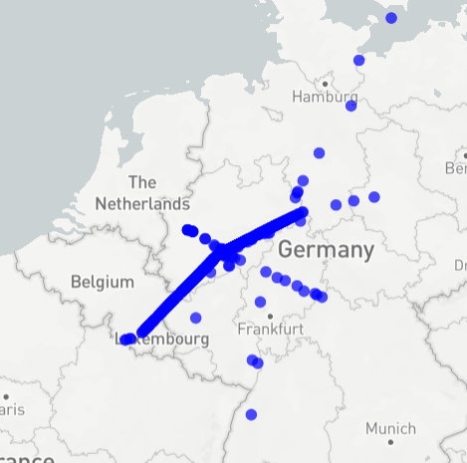
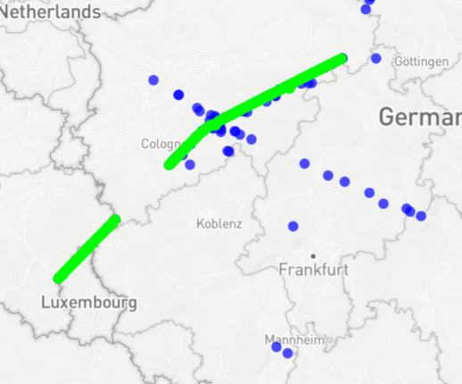
Trajectory estimation
Per Trajectory
Input Timestamps/Sensors
Multilateration
Weighted Points
Trajectory splitting
Outlier Removal
Sensor IDs
Sensor Comb. Info
Weighted Piecewise linear Fit
Weights

